Slide 1

Calculate the following
$1^{2}=1×1=1$
$2^{2}$
$3^{2}$
$4^{2}$
$5^{2}$
$6^{2}$
$7^{2}$
$8^{2}$
$9^{2}$
${10}^{2}$
${11}^{2}$
${12}^{2}$

Slide 2
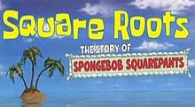
Lesson objective
By the end of this lesson you will be able to;
- Find the square root of square numbers
Notes:
Lesson

Slide 3
Calculate the following
$1^{2}=1×1=1$
$2^{2}=2×2=4$
$3^{2}=3×3=9$
$4^{2}=4×4=16$
$5^{2}=5×5=25$
$6^{2}=6×6=36$
$7^{2}$
$8^{2}$
$9^{2}$
${10}^{2}$
${11}^{2}$
${12}^{2}$

Slide 4
Calculate the following
$1^{2}=1×1=1$
$2^{2}=2×2=4$
$3^{2}=3×3=9$
$4^{2}=4×4=16$
$5^{2}=5×5=25$
$6^{2}=6×6=36$
$7^{2}=7×7=49$
$8^{2}=8×8=64$
$9^{2}=9×9=81$
${10}^{2}=10×10=100$
${11}^{2}=11×11=121$
${12}^{2}=12×12=144$

Slide 5
24
7
30
Date
Index Notation
EQ – Describe the relationship between squaring a number and finding the square root?
9

Slide 6
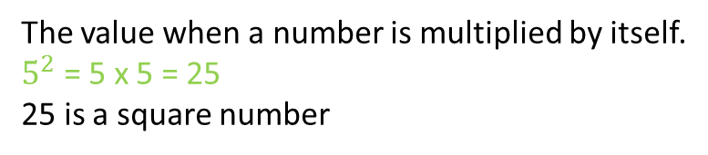
24
7
30
Date
Index Notation
EQ – Describe the relationship between squaring a number and finding the square root?
What is a square number?
The value when a number is multiplied by itself.
$5^{2}$ = 5 x 5 = 25
25 is a square number
9

Slide 7
24
7
30
Date
Index Notation
EQ – Describe the relationship between squaring a number and finding the square root?
What is a square number?
The value when a number is multiplied by itself
$5^{2}$ = 5 x 5 = 25
25 is a square number
What the square root?
9

Slide 8
24
7
30
Date
Index Notation
EQ – Describe the relationship between squaring a number and finding the square root?
What is a square number?
The value when a number is multiplied by itself
$5^{2}$ = 5 x 5 = 25
25 is a square number
What the square root?
The inverse operation to squaring
$$\sqrt{25}=5$$
9

Slide 9
Calculate the following
$\sqrt{1}=1$
$\sqrt{4}=$
$\sqrt{9}=$
$\sqrt{16}=$
$\sqrt{25}=$
$\sqrt{36}=$
Extention
$\sqrt{400}=$
$\sqrt{49}=$
$\sqrt{64}=$
$\sqrt{81}=$
$\sqrt{100}=$
$\sqrt{121}=$
$\sqrt{144}=$
$\sqrt{2500}=$

Slide 10
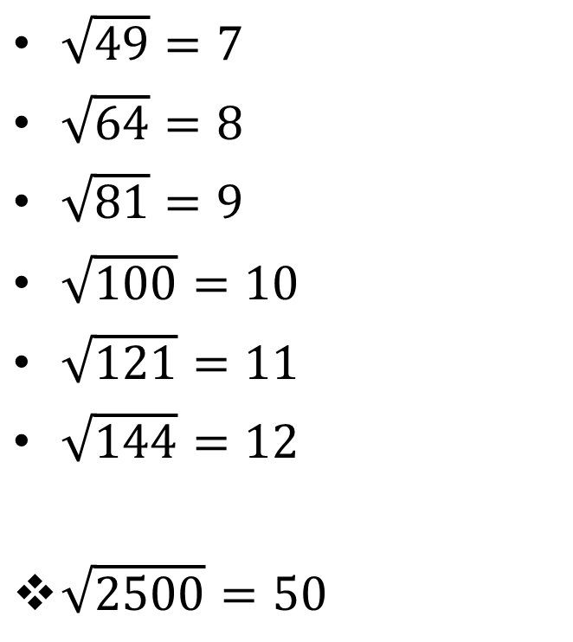
Calculate the following
$\sqrt{1}=1$
$\sqrt{4}=2$
$\sqrt{9}=3$
$\sqrt{16}=4$
$\sqrt{25}=5$
$\sqrt{36}=6$
Extention
$\sqrt{400}=20$
$\sqrt{49}=7$
$\sqrt{64}=8$
$\sqrt{81}=9$
$\sqrt{100}=10$
$\sqrt{121}=11$
$\sqrt{144}=12$
$\sqrt{2500}=50$

Slide 11
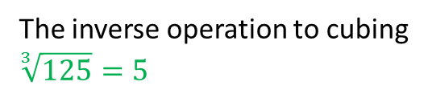
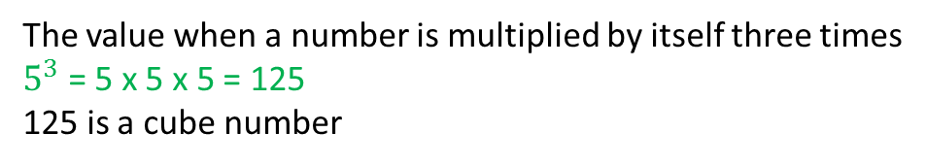
24
7
30
Date
Index Notation
EQ – Describe the relationship between squaring a number and finding the square root?
What is a square number?
The value when a number is multiplied by itself
$5^{2}$ = 5 x 5 = 25
25 is a square number
What the square root?
The inverse operation to squaring
$$\sqrt{25}=5$$
What is a cube number?
The value when a number is multiplied by itself three times
$5^{3}$ = 5 x 5 x 5 = 125
125 is a cube number
The inverse operation to cubing
$$\sqrt[3]{125}=5$$
What the cube root?
9

Slide 12

Cube numbers
$$1^{3}=1×1×1=1$$
$2^{3}=2×2×2=$__
$$3^{3}= \\ 4^{3}= \\ 5^{3}=$$
Notes:
Independent practice

Slide 13
Square root day
Math fans loved March 3, 2009 (3/3/09). It was called Square Root Day. Square Root Day happens only nine times in a century. Square Root Day is not an official holiday. Math lovers celebrate anyway!
A California high school teacher named Ron Gordon created the day for 9/9/81
Notes:
Closure

Slide 14
Square root day
Math fans loved March 3, 2009 (3/3/09). It was called Square Root Day. Square Root Day happens only nine times in a century. Square Root Day is not an official holiday. Math lovers celebrate anyway!
A California high school teacher named Ron Gordon created the day for 9/9/81
There was one last year (4/4/16)
When will the next square root day happen?

